Slide 1

Chapter 11
Media and Interactivity Basics
Key Concepts
Copyright © 2013
Terry Ann Morris, Ed.D

Slide 2
Learning Outcomes
Describe types of multimedia files used on the Web
Configure hyperlinks to multimedia files
Configure audio and video on a web page with HTML5 elements
Configure a Flash animation on a web page
Use the CSS3 transform and transition properties
Describe the purpose of the HTML5 canvas element

Slide 3
Helper Applications & Plug-ins
Helper Application
  A program that can be designated to handle a particular file type (such as .wav or.mpg) to allow the user to view or otherwise utilize the special file.
  The helper application runs in a separate window from the browser.
Plug-In
  A newer and more common method
  Plug-ins run right in the browser window so that media objects can be integrated directly into the web page.

Slide 4
Containers & Codecs
Container
  Designated by the file extension – contains the media and metadata
Codec
  The algorithm used to compress the media
HTML5 audio & video
  Native to the browser
  Browsers do not support the same codecs

Slide 5
Commonly Used Plug-ins
Adobe Flash Player
Adobe Reader
Windows Media Player
Apple Quicktime

Slide 6
Common Audio File Types
.wav Wave File
.aiff Audio Interchange File Format
.mid Musical Instrument Digital Interface (MIDI)
.au Sun UNIX sound file
.mp3 MPEG-1 Audio Layer-3
.ogg Ogg Vorbis (open-source)
. m4a MPEG 4 Audio.
This audio-only MPEG-4 format is supported by Quicktime, iTunes, and iPods.

Slide 7
Common Video File Types
.mov Quicktime
.avi Microsoft Audio Video Interleaved
.wmv Windows Media File
.flv Flash Video File
.mpg MPEG (Motion Picture Experts Group)
.m4v .mp4 (MPEG-4)
.ogv Ogg Theora (open-source)
.webm VP8 codec (open video format, free)

Slide 8
Copyright Issues
Only publish web pages, images, and other media that you have personally created or have obtained the rights or license to use.
Ask permission to use media created by another person instead of simply “grabbing” it.
All work (including web pages) are automatically copyrighted even if there is not copyright mark or date.
Fair Use Clause of the Copyright Act
Creative Commons – A new approach to copyright

Slide 9
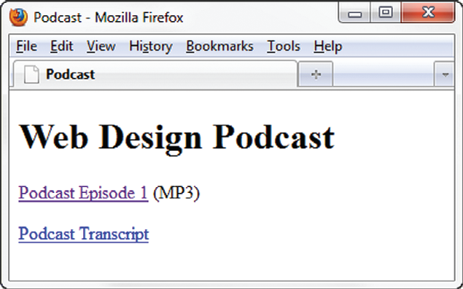
Configure Audio & Video
Most basic method to provide audio or video files:
  Hyperlink
  <a href=“wdfpodcast.mp3" title=“Web Design Podcast”>Web Design Podcast</a>

Slide 10
Multimedia & Accessibility
Provide alternate content
  Transcript (for audio)
  Captions (for video)
  Text format

Slide 11
What is Adobe Flash?
A popular multimedia application
Create multimedia which adds visual interest and interactivity to web pages
Flash movies are saved in “.swf” files
Perception of speedy display
.swf files play as they download
Flash Player
  Free browser plug-in
  Widely installed on browsers

Slide 12
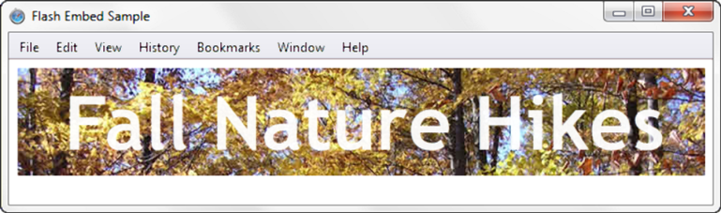
HTML5 Embed Element
<embed type="application/x-shockwave-flash"
src="fall5.swf"
width="640"
height="100"
quality="high”
title="Fall Nature Hikes">

Slide 13
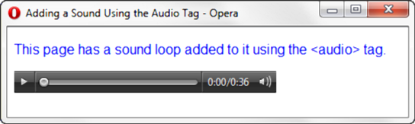
HTML5 Audio & Source Elements
<audio controls="controls">
<source src="soundloop.mp3" type="audio/mpeg">
<source src="soundloop.ogg" type="audio/ogg">
<a href="soundloop.mp3">Download the Audio File</a> (MP3)
</audio>

Slide 14
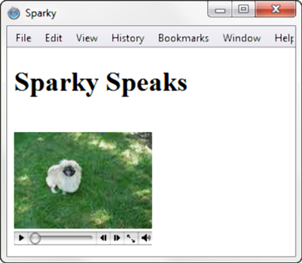
HTML5 Video & Source Elements
<video controls="controls" poster="sparky.jpg"
width="160" height="150">
<source src="sparky.m4v" type="video/mp4">
<source src="sparky.ogv" type="video/ogg">
<a href="sparky.mov">Sparky the Dog</a> (.mov)
</video>

Slide 15
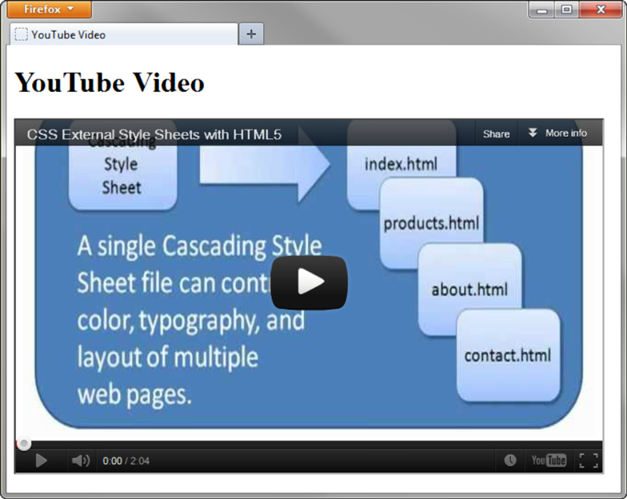
Use the iframe element to embed YouTube Video
<iframe src="http://www.youtube.com/embed/VIDEO_ID" width="640" height="385">
View the
<a href="http://www.youtube.com/watch?v=VIDEO_ID">YouTube Video</a>
</iframe>

Slide 16
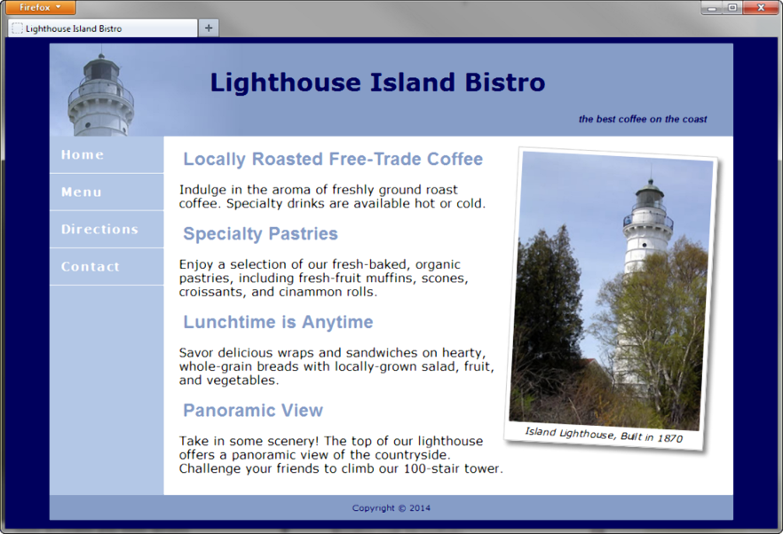
CSS3 Transform Property
Allows you to rotate, scale, skew, or move an element
Example:
-webkit-transform: rotate(3deg);
-moz-transform: rotate(3deg);
-o-transform: rotate(3deg);
-ms-transform: rotate(3deg);
transform: rotate(3deg);

Slide 17

CSS3 Transition Property
Provides for changes in property values to display in a smoother manner over a specified time.
Example:
nav a:hover { color: #869dc7; background-color: #eaeaea;
-webkit-transition: background-color 2s linear;
-moz-transition: background-color 2s linear;
-o-transition: background-color 2s linear;
transition: background-color 2s linear; }

Slide 18
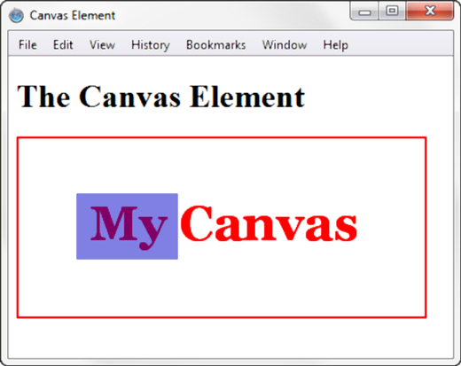
HTML5 Canvas Element
Configures dynamic graphics
  Draw lines, shapes, text, image
  Interact with actions taken by the user
Canvas API (application programming interface)
JavaScript – client-side scripting language
<script>
function drawMe() {
var canvas = document.getElementById("myCanvas");
if (canvas.getContext) {
var ctx = canvas.getContext("2d");
ctx.fillStyle = "rgb(255, 0, 0)";
ctx.font = "bold 3em Georgia";
ctx.fillText("My Canvas", 70, 100);
ctx.fillStyle = "rgba(0, 0, 200, 0.50)";
ctx.fillRect (57, 54, 100, 65);
}
}
</script>

Slide 19
Summary
This chapter introduced the HTML techniques and technologies used to configure sound, video, and interactivity on web pages.
Issues related to accessibility and copyright were also discussed.
The number one reason for visitors to leave web pages is too long of a download time. When using multimedia, be careful to minimize this issue.

